Slide 1
Midterm Presentation
Caela Goins, Edwin Catalan, Quadre Jackson

Slide 2
Topic Introduction
Twenty Questions
We are creating an online guessing game
The goal of the game is to have an object that the game didn't guess
Example:
Animal Category: User will think of an animal and answer questions based on what animal they're thinking of.
After so many questions, the game will try and guess

Slide 3
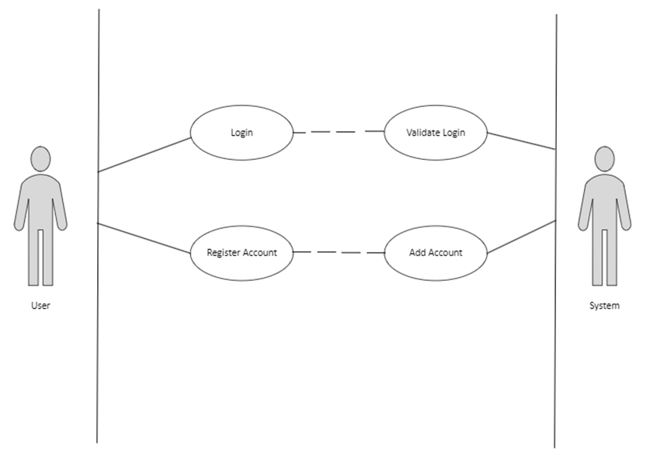
Key Functional Requirement 1

Slide 4
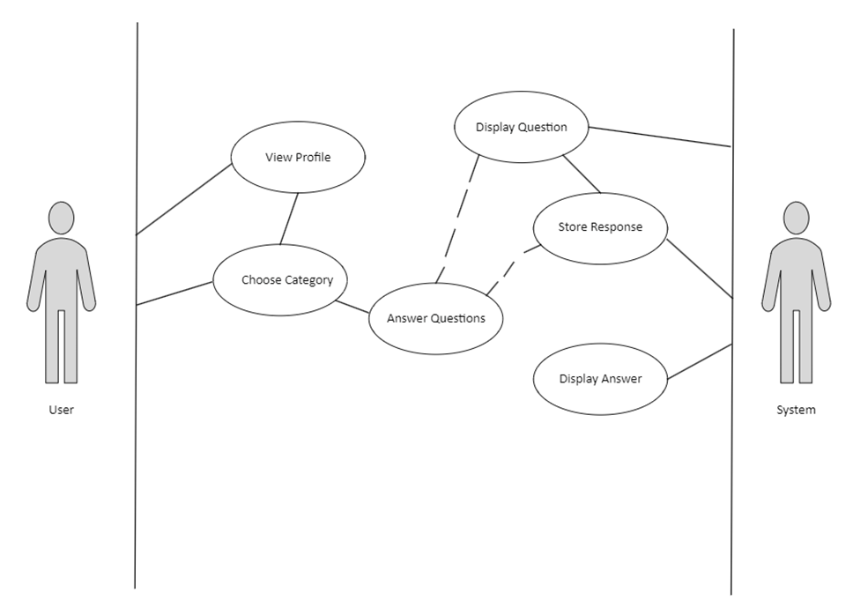
Key Functional Requirement 2

Slide 5
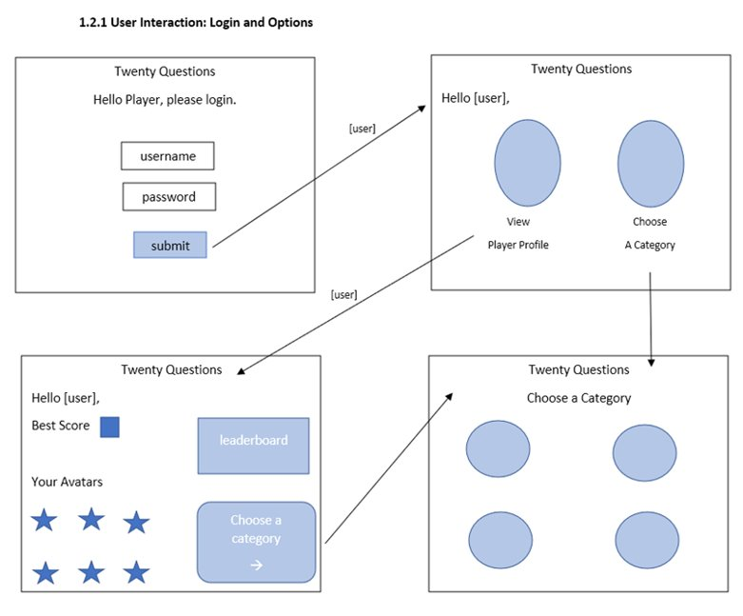
Main User Interface 1

Slide 6
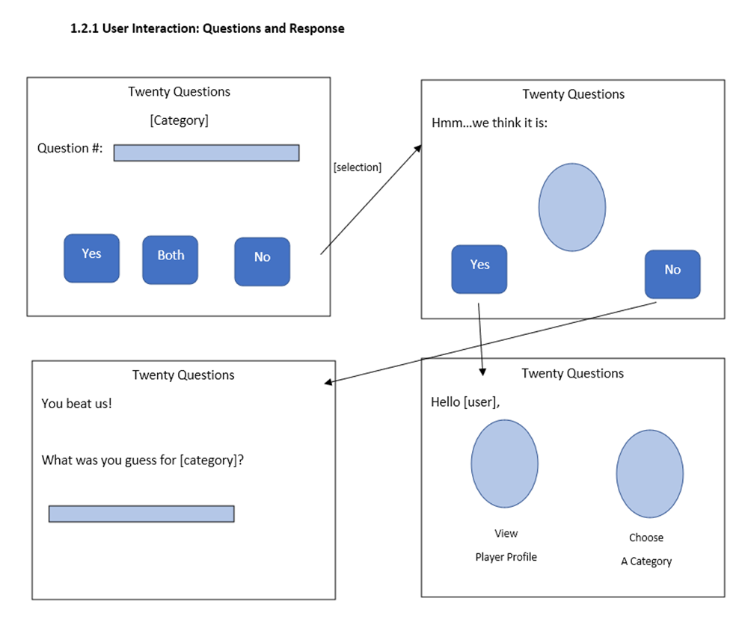
Main User Interface 2

Slide 7
Class Diagram

Slide 8
Database Design

Slide 9
Test Case 1: User Login
Test Case | Description | Input | Expected Output | Pass/Fail
1 | Login with correct username & password | User1 password | Login Success | Pass
2 | Login with incorrect password | User1 user | Login Failure | Fail
3 | Login with incorrect username | User password | Login Failure | Fail
4 | Login with nonexistent credentials | UserTwo ThisIsMyPassword | Login Failure | Fail

Slide 10
Test Case 2: User Response
Test Case # | Test Description | Test Data | Expected Result | Status
1 | User clicks on response button | Known: Username Password | Successful transition to next question | Pass/Fail
2 | Check questions appear in correct order | Known: User response to previous question | Successful transition to next appropiate question | Pass/Fail
3 | Player profile displays when user clicks option | Known: Username | Successful display of user profile page | Pass/Fail
4 | Player category displays when user clicks option | Known: Username | Successful display of user category page | Pass/Fail
5 | Player game displays when user selects a category | Known: Category | Successful display of user game page | Pass/Fail

